Slide 1
Are you hungry and in a hurry to get to class?

Slide 2
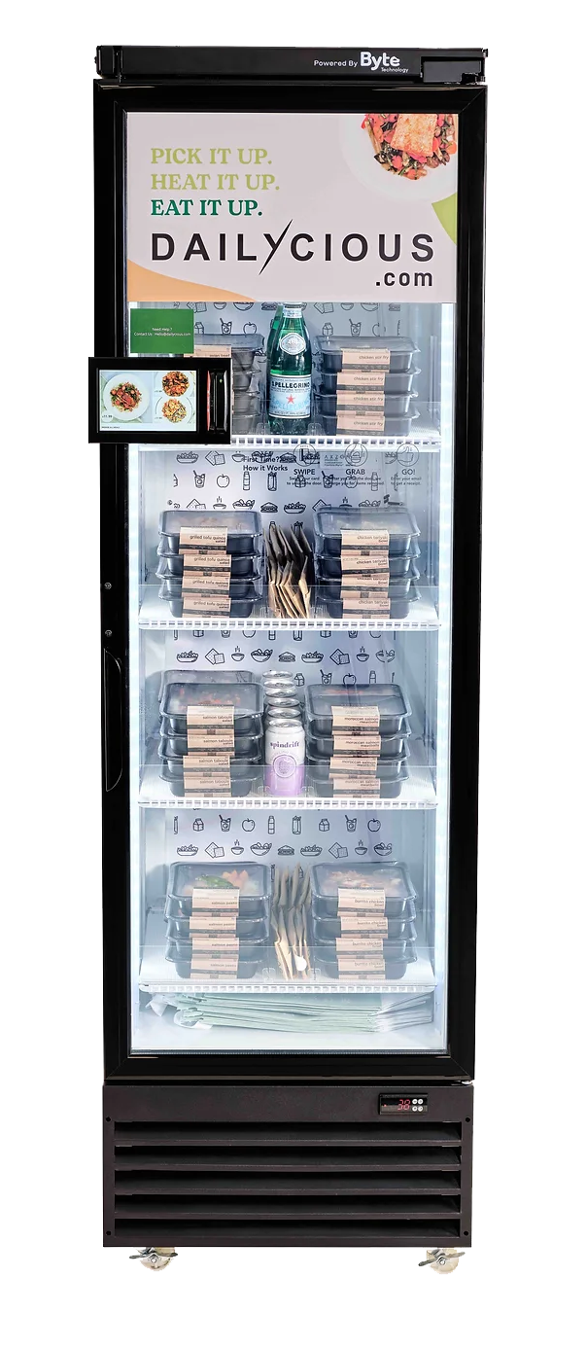
Meal Vending Machine
At USC
Group H:
Anna Natasha, Aaryavardhan Rathore, Donya Damavandi, Jay Maniyar, Samantha Sy, Yiwen Mei, Yuqing (Helen) Yang

Slide 3
TABLE OF CONTENTS
Introduction
01
04
Segmentation
Analysis
02
05
Objective & Method
Market & Pricing Analysis
Conjoint Analysis
03
06
Managerial Implications

Slide 4
01
Problem
At USC getting a healthy, filling meal is inconvenient. With only drink machines and cafeterias, the long line and prep time takes forever to get food!
Notes:
Anna

Slide 5
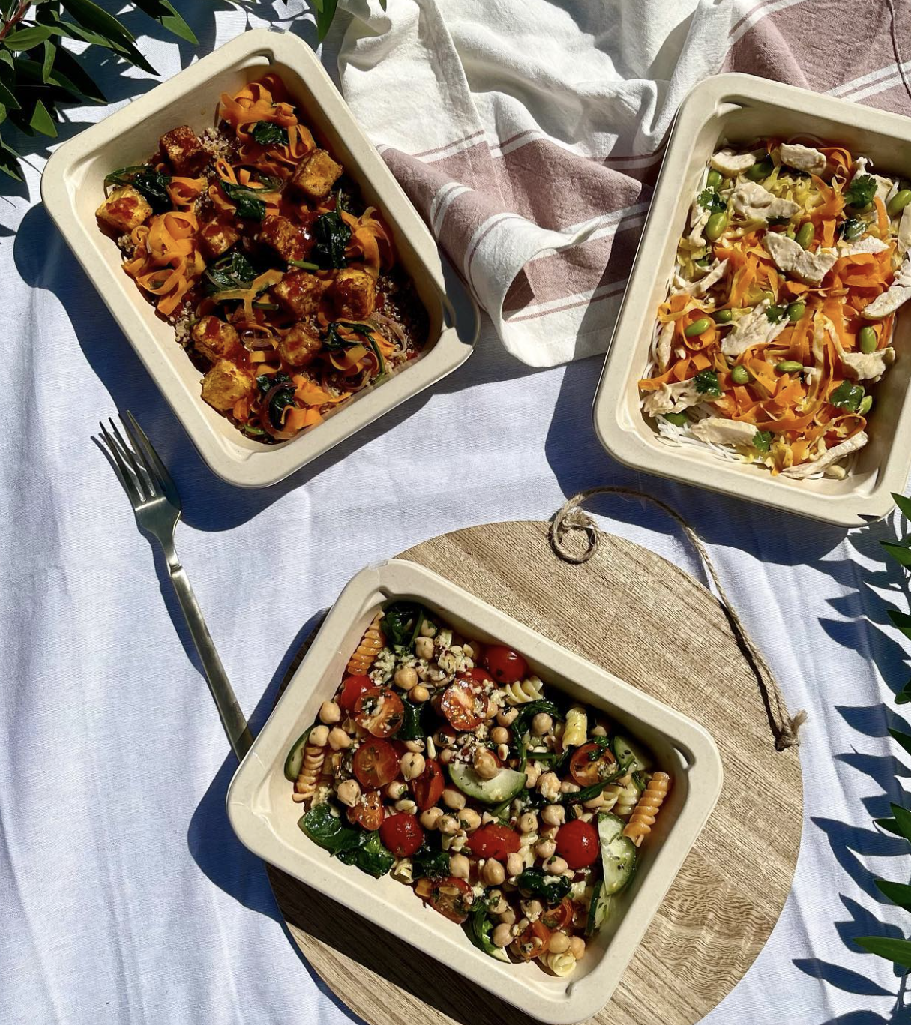
01
Introduction
Food
Vending Machine
The perfect solution for busy individuals who want to enjoy healthy and delicious meals on-the-go in under 3 minutes!
Notes:
Introducing..
Dailycious Vending Machines: Fresh food at the click of a button!

Slide 6
02
Method: Conjoint Survey
Conjoint Survey with 100 respondents
Should USC Install Food Vending Machines?
1. Understand the demand for a food vending machine.
2. Identify the attributes students and staff care about in meals.
3. Inform feature selection and pricing strategy based on preferences.

Slide 7





02
Key Attributes
Vegan/Vegetarian Dish
Yes: This is a vegan or vegetarian dish
No: The product is not vegetarian-friendly
Frozen/Fresh
Frozen (1 month shelf life)
Fresh (3-4 days of shelf life)
Portion Size
Medium (500-700 calories)
Large (700-900 calories)
Meal Price $9, $12, or $15
Rotating Menu
Yes: the menu changes every week
No: the menu is fixed

Slide 8
02
Behavioral Questions
Age Group
Role at USC
Gender Identity
Meal Purchase Habits:
How often do you purchase meals at school per week?

Slide 9
Analysis: Survey Demographics
03
Survey completed by a total of 100 respondents,
with an average response time of 4 minutes
Most of our survey respondents are graduate students aged between 22 and 34
64% of the respondents are male, while 36% are female
65% of the respondents purchase meals at school 1-3 times per week,
13% purchase meals at school more than 3 times per week,
and 22% never purchase meals at school
Notes:
Helen

Slide 10
Analysis: Willingness-To-Pay
03
Willingness-To-Pay for an attribute level change is the max $ amount a customer would pay for the change.
WTP = Utility difference * Price per Utility Unit
Dollar value of 1 utility = 0.036
Customers are willing to pay $3.87 more for Fresh over Frozen.
Customers are willing to pay $0.03 more for a Vegan/Vegetarian Dish.
Customers are willing to pay $1.91 more for a Rotating Menu.
Customers are willing to pay $0.16 more for a Large Portion over Medium.

Slide 11
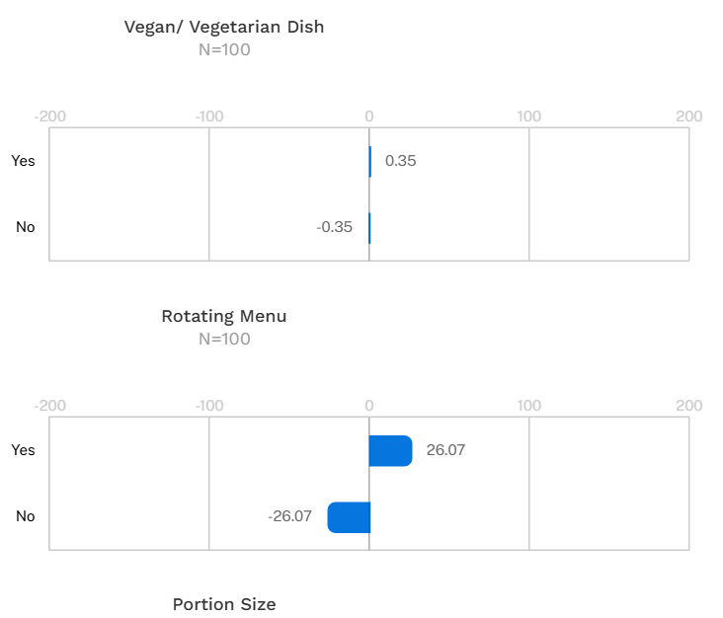
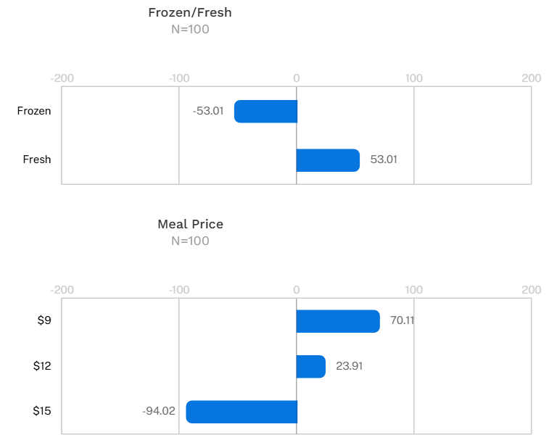
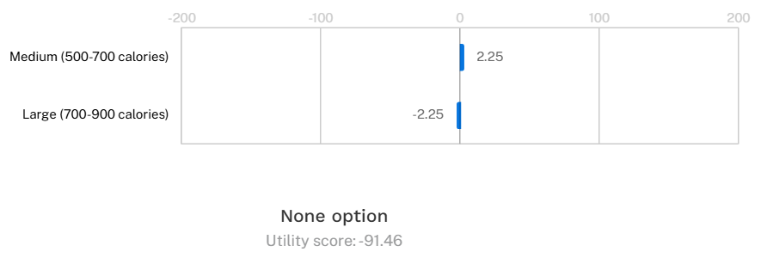

Slide 12
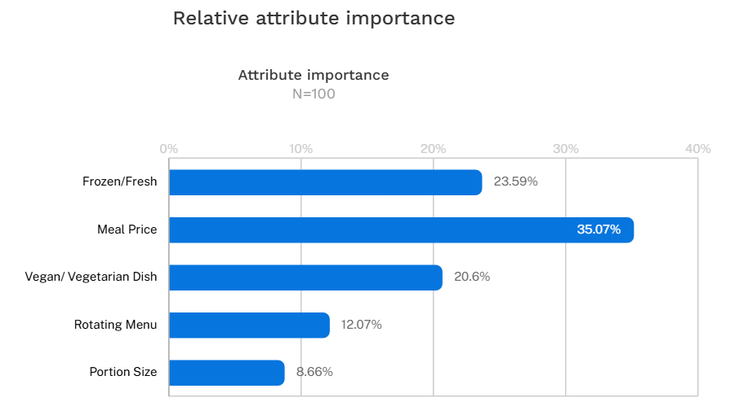

Slide 13
Segmentation Analysis
04
3 Segment
5 Segment
Groups | AIC | BIC
1 | 915.96 | 943.90
2 | 869.54 | 929.42
3 | 832.27 | 924.08
4 | 802.58 | 926.31
5 | 788.28 | 943.95
3 Segment Sizes | 12.1% | 17.2% | 70.7%
Attribute Importances
Frozen/Fresh | 8.94 | 23.32 | 29.07
Meal Price | 66.19 | 21.73 | 47.79
Rotating Menu | 4.48 | 0.69 | 13.17
Vegan/ Vegetarian Dish | 14.28 | 52.59 | 3.65
Portion Size | 6.11 | 1.67 | 6.32
None | 140.87 | 66.18 | -372.24
5 Segment Sizes | 13.3% | 27.6% | 17.8% | 22.6% | 18.7%
Attribute Importances
Frozen/Fresh | 6.7 | 52.8 | 23.4 | 14.9 | 15.7
Meal Price | 76.6 | 13.2 | 22.6 | 40.3 | 71.6
Rotating Menu | 3.4 | 20.6 | 0.1 | 12.7 | 2.2
Vegan/ Vegetarian Dish | 8.9 | 6.3 | 51.9 | 5.5 | 5.2
Portion Size | 4.2 | 6.9 | 1.4 | 27.2 | 5.1
None | 144.22 | -243.41 | 63.91 | -306.03 | -287.12
Notes:
Donya

Slide 14


04
Customer Profiles
Budget Meal Seekers
12.1% population
Healthy Enthusiasts
17.2% population
Adventurous Fresh Foodies
70.7% population
Highly price-sensitive customers with utility value that they’re unlikely to consider our product
Heavy emphasis on fresh, vegan/vegetarian meals and are open to considering our product
Majority of the population who values fresh, good-quality meals and enjoys exploring new dishes that are reasonably priced- most receptive to our product

Slide 15
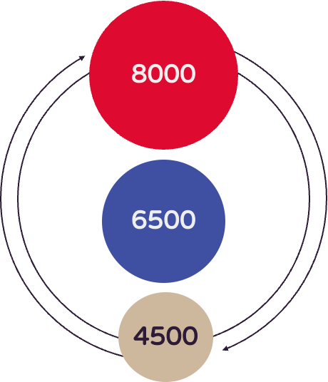
5
Market Sizing Overview
05
Total Addressable Market (TAM)
Marshall Undergrads (4,200), Grads (3,300), Faculty & Staff (500)
Serviceable Addressable Market (SAM)
Based on survey results, Marshall Undergrads (3,600), Grads (2,500), Faculty & Staff (400) that consume food at Marshall
Serviceable Obtainable Market (SOM)
Target Audience: Marshall Undergrads (2,500), Grads (1,700), Faculty & Staff (300)
Notes:
Helen

Slide 16



05
Profit Analysis
Revenue
Costs
Profits
Per Week
Price: 12$
WTP ranges: 9-12 and 12-15
Weekly Demand: 13,000
Target Segment: 9,000 (70%)
Adoption: 2,000 (24%)
Fixed Costs: 15,000$
Unit Costs (variable): 6$
Additional Costs: 3$
Margin: 20.0%
Revenue - Costs = $2,500 (24,000-21,500)

Slide 17
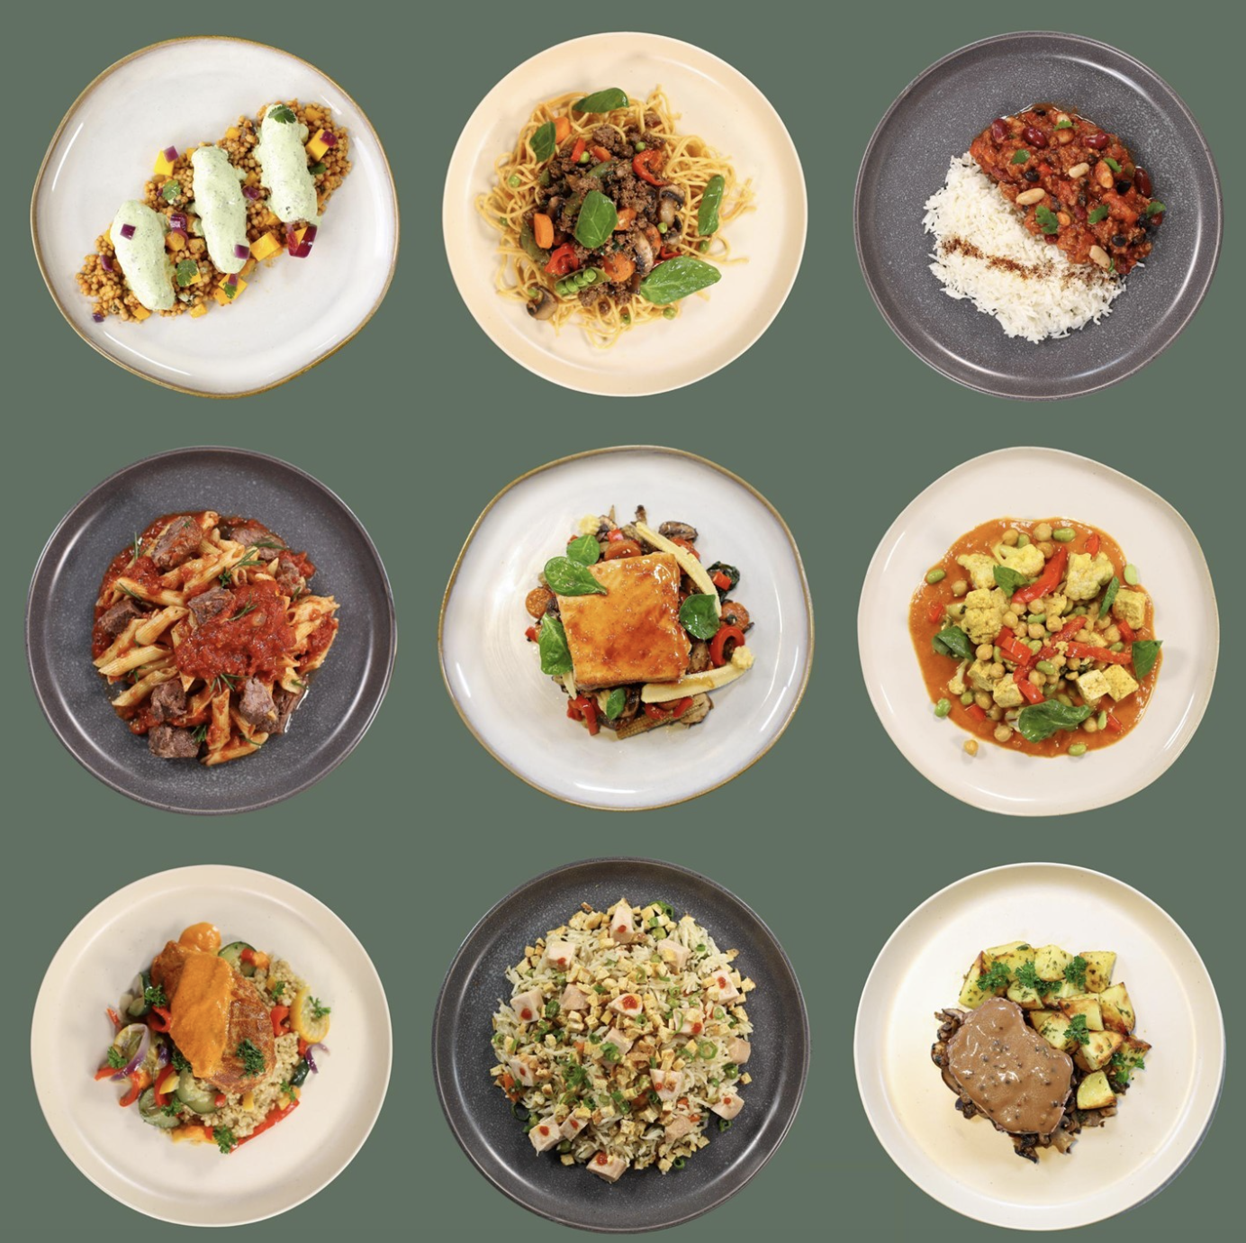
06
Recommendations and Managerial Implications
Pricing Strategy
Willing to pay $3.5 more for fresh food over frozen meals
The seasonal products can be marked at $2 more than the regular products
Optimal Implementation Strategy
Capacity: 500 units/week, Profit: $600/week
Will start with with JKP and JFF
Next, between HOH and BRI
As we start earning profits, we implement all across USC

Slide 18
Thank You!
Group H:
Anna Natasha, Aaryavardhan Rathore, Donya Damavandi, Jay Maniyar, Samantha Sy, Yiwen Mei, Yuqing (Helen) Yang

Slide 19
Appendix

Slide 20
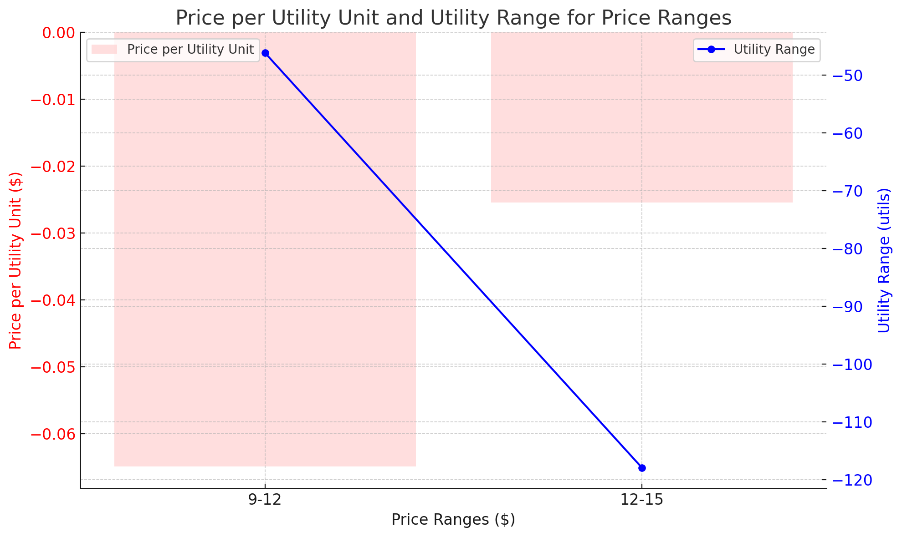
Notes:
Helen

Slide 21
GRADS | Total | 1-3 meals a week | 3+ meals a week | never
Survey | 91 | 57.00 | 12.00 | 22.00
Sample Proportion |  | 0.63 | 0.13 | 0.24
Population | 3200 | 2004.40 | 421.98 | 773.63
Avg Meals |  | 2.00 | 4.00 | 0.00
Total meals | 5696.7 | 4008.79 | 1687.91 | 0.00
UNDERGRADS | Total | 1-3 meals a week | 3+ meals a week | never
Survey | 10 | 6.00 | 2.00 | 2.00
Sample Proportion |  | 0.60 | 0.20 | 0.20
Population | 3200 | 1920.00 | 640.00 | 640.00
Avg Meals |  | 2.00 | 4.00 | 0.00
Total meals | 6400 | 3840.00 | 2560.00 | 0.00
Faculty/Staff | Total | 1-3 meals a week | 3+ meals a week | never
Survey | 10 | 7.00 | 2.00 | 1.00
Sample Proportion |  | 0.70 | 0.20 | 0.10
Population | 400 | 280.00 | 80.00 | 40.00
Avg Meals |  | 2.00 | 4.00 | 0.00
Total meals | 880 | 560.00 | 320.00 | 0.00

Slide 22
Computation for WTP
1. Fresh vs. Frozen
Utility difference = U(Fresh) - U(Frozen) = 53.01−(−53.01)=106.02utils
WTP = Utility difference * Price per Utility Unit
WTP = 106.02×0.03655=3.87dollars
Customers are willing to pay $3.87 more for Fresh over Frozen.
2. Vegan/Vegetarian Dish (Yes vs. No)
Utility difference = U(Yes) - U(No) = 0.35−(−0.35)=0.70utils
WTP = Utility difference * Price per Utility Unit
WTP = 0.70×0.03655=0.03dollars
Customers are willing to pay $0.03 more for a Vegan/Vegetarian Dish.
Utility Range for Price
Utility for $9: 70.11
Utility for $12: 23.91
Utility for $15: -94.02
Utility Range = U($9) - U($15) = 70.11- (-94.02) = 164.13 utils
Price Range = $15 - $9 = 6 dollars
Price per Utility Unit =
Price Range / Utility Range =
6 / 164.13 = 0.03655 dollars per util 0.02789 dollarsper util
3. Rotating Menu (Yes vs. No)
Utility difference = U(Yes) - U(No) = 26.07−(−26.07)=52.14utils
WTP = Utility difference * Price per Utility Unit
WTP = 52.14×0.03655=1.91dollars
Customers are willing to pay $1.91 more for a Rotating Menu.
4. Portion Size (Large vs. Medium)
Utility difference = U(Large) - U(Medium) = 2.25−(−2.25)=4.50utils
WTP = Utility difference * Price per Utility Unit
WTP = 4.50×0.03655=0.16dollars
Customers are willing to pay $0.16 more for a Large Portion over Medium.

Slide 23
